Slide 1
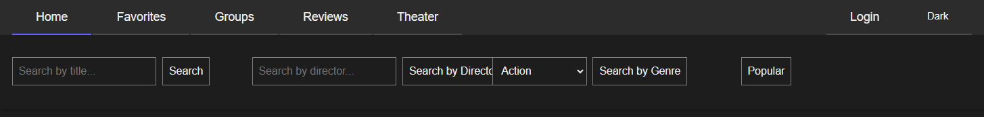

MovieApp
Project Presentation
Web programming application project

Slide 2

Team and Roles
Samuli Kokko – fullstack development, architecture and project leading
User management, Finnkino showtimes, project documentation, application architecture, database design and publification in Render, Mocha tests and movie reviews
240 hours
Janne Saarela – fullstack development
Search movies, All groups, create groups feature, group pages add and delete movies to group, add showtimes to group, my info, Manage groups joinrequests, deletegroup, leave group
110 hours
Nico Lappalainen – fullstack development and project leading
Kirjoita mitä teit
110 hours
Mirella Lampinen – fullstack development
Show groupmembers, delete groupmembers, Group page customization, moviecard component, responsiveness, light and dark mode
115 hours

Slide 3
Technologies
Backend
Node.js
Express
PostgreSQL (pg)
JSON Web Token (jsonwebtoken)
bcrypt
Mocha & Chai (testing)
dotenv
Frontend
React (Vite)
React Router DOM
Axios
React Hot Toast
Font Awesome (FortAwesome)

Slide 4

Functionalities Checklist
Status |  | Description
 | 1. | Responsive design – Layout adapts to different screen sizes.
 | 2. | User registration – Create an account with email and secure password.
 | 3. | Login & logout – Sign in and out with your user credentials.
 | 4. | Account deletion – Remove your account and related data.
 | 5. | Movie search – Search movies by at least three criteria.
 | 6. | Showtimes – Browse Finnkino theaters and movie schedules.
 | 7. | Group page – Create, view, and delete movie discussion groups.
 | 8. | Join requests – Send and approve group join requests.
 | 9. | Member removal – Owner can remove members; users can leave groups.
 | 10. | Group customization – Add movies and showtimes to your group page.
 | 11. | Movie reviews – Logged-in users can write and rate reviews (1–5 stars).
 | 12. | View reviews – All users can browse reviews and movie info.
 | 13. | Favorites list – Logged-in users can create their personal favorites list.
 | 14. | Share favorites – Share your favorites via a public link (URI).
 | 15. | Light and dark mode– User can switch between light and dark mode
 | 16. | Published application – Application published in Render

Slide 5

Documentation & Testing
Tests
Sign in
Sign out
Registeration
Account delete
Reviews: get, delete and add
Documentation
Readme.md
API documentation
Database diagram
Scrum board
UI sketches

Slide 6

Challenges and Solutions
User token handling
Took a long time to get refresh token to work. New concept for us.
We use a secure token-based system:
Access token stored in memory and sent in the Authorization header
Refresh token stored as an HTTP-only cookie
When the access token expires, a new one is issued automatically
Backend routes and controllers
Code flow and multiple files handling
React component handling
for example, favorite and group buttons

Slide 7

Learnings
How to build a full-stack web application using React, Node.js, Express, and PostgreSQL.
How to build a full-stack web application using React, Node.js, Express, and PostgreSQL.
We practiced team collaboration and version control with GitHub
We also improved our problem-solving and debugging skills through real project challenges
Right now, we are improving our presentation skills in English

Slide 8
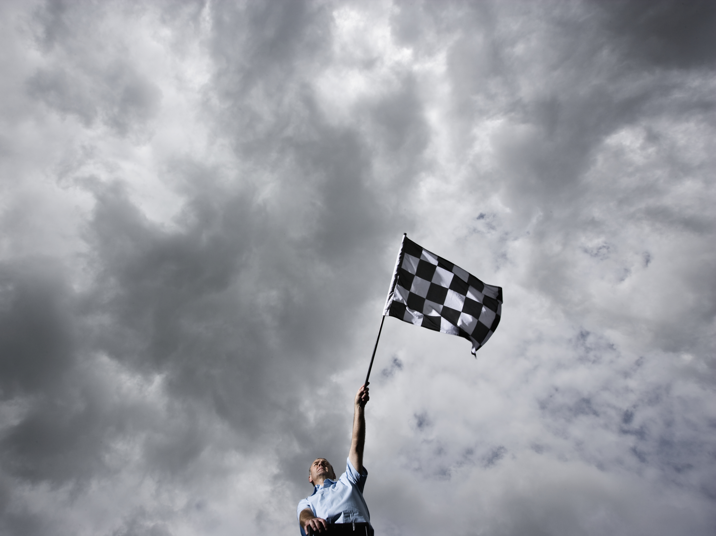
Successes
Team work worked well. Everyone was present in every meeting and remained active during the entire project.
Application is working, published and every requirement fulfilled

Slide 9

Future Improvements
Refining the user experience and UI
Implementing more testing
Improving code reliabality and error proofing
Refactoring the code
After that, new features:
More social features

Slide 10


